Slide 1

Getting the Most Out of Microsoft Outlook
Smarter Email, Calendar, and Productivity at Work
Presented by Hari Vatte

Slide 2

Today's Agenda
Why Outlook Matters
Key Features Overview
Understanding the central role of Outlook in modern workplace communication
Navigate the interface and essential tools with confidence
Productivity Tips
Q&A
Practical strategies to work smarter and save time daily
Your questions answered and additional guidance

Slide 3

Why Outlook Matters in Your Daily Work
Central Communication Hub
Outlook consolidates email, calendar, contacts, and tasks in one powerful platform
Enhanced Organization
Systematically manage messages, appointments, and priorities without missing critical information
Seamless Collaboration
Support remote and hybrid work with integrated Teams meetings and shared calendars
Reduced Confusion
Clear communication trails and organized workflows minimize miscommunication and delays

Slide 4
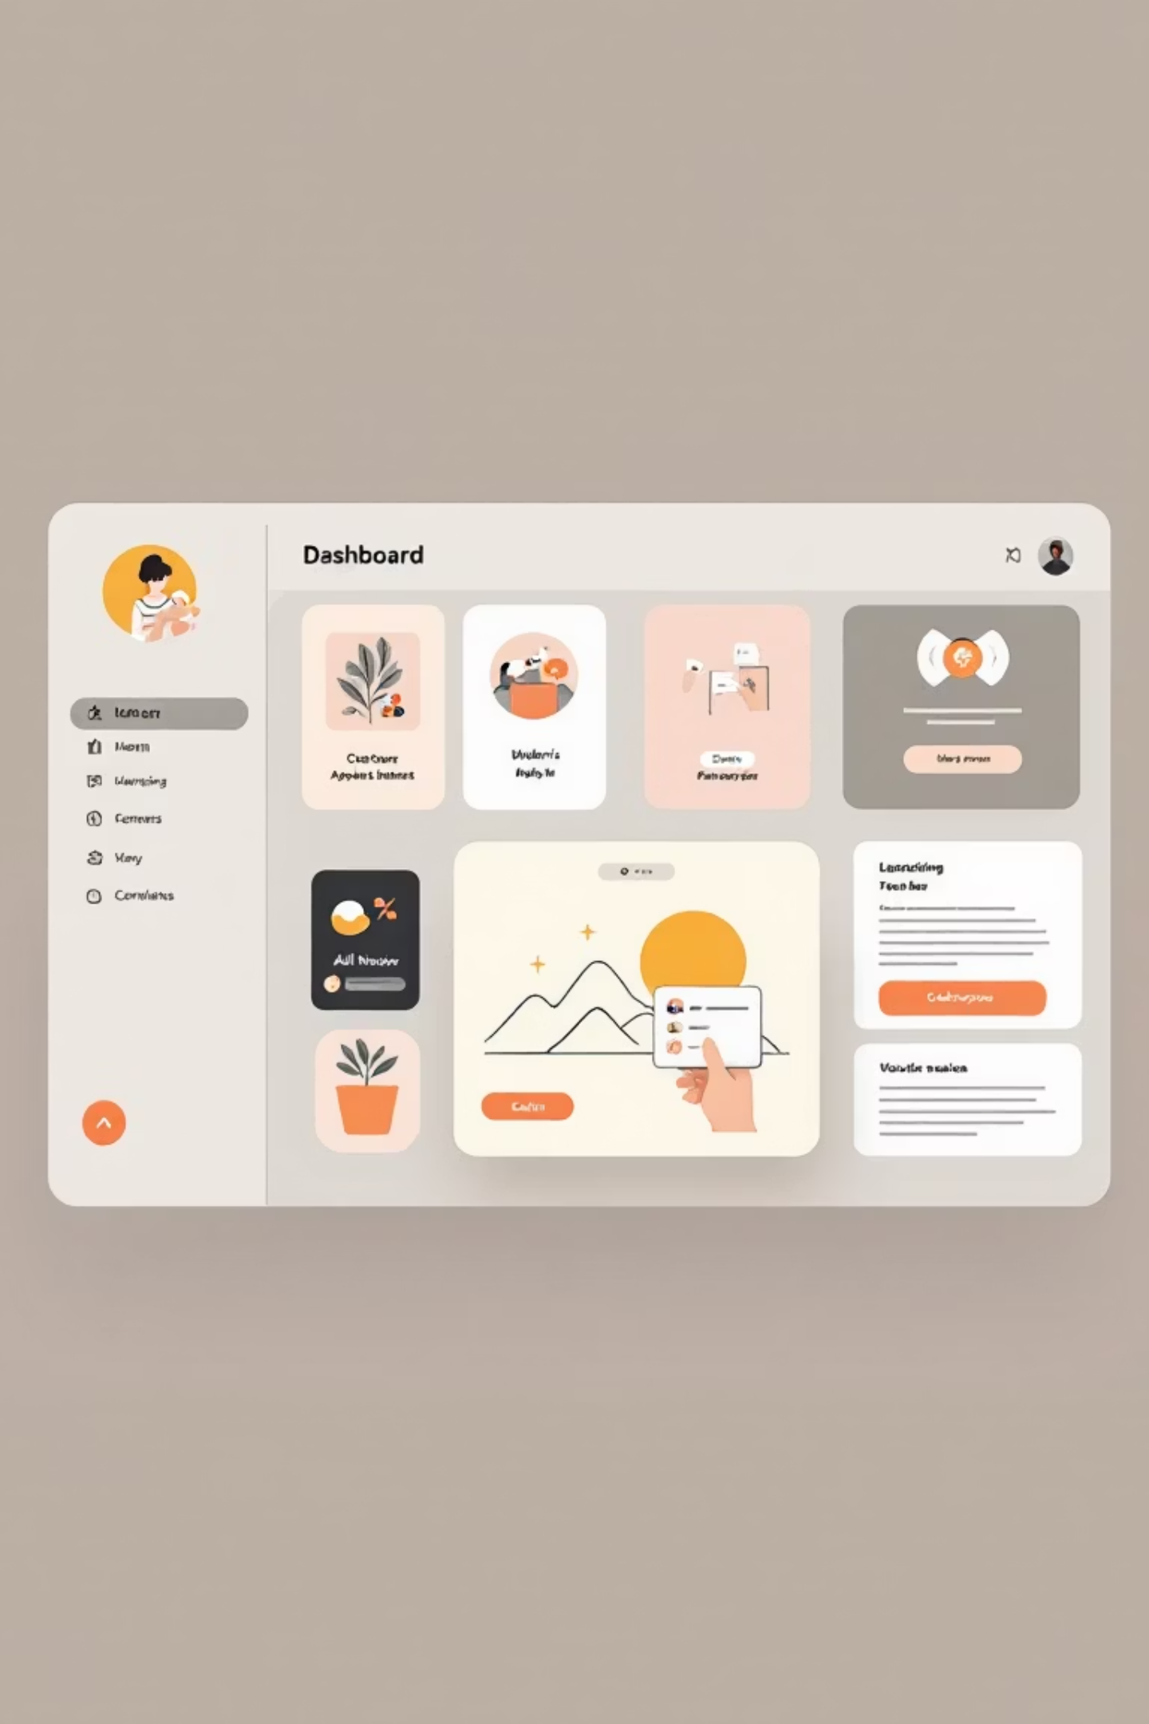
Understanding the Outlook Interface
Mastering these three key areas will transform how you work with Outlook every day.
01
02
Navigation Pane
Message List
Your control center on the left side displays folders, favorites, and mailbox structure. Quickly switch between Mail, Calendar, People, and Tasks to access everything you need.
The center panel shows all your emails in the selected folder. Sort by date, sender, or importance. Preview subject lines and identify unread messages at a glance.
03
Reading Pane
The right panel displays full message content without opening a new window. Review emails efficiently while maintaining your workflow and context.

Slide 5
Mastering Your Inbox
Transform email chaos into organized efficiency with these powerful Outlook features.
Categories & Folders
Flags and Follow-Up
Color-code messages by project, urgency, or department. Create custom folders to separate work types and keep your inbox clean and navigable.
Mark important emails for action with flag reminders. Set due dates and receive notifications to ensure nothing falls through the cracks.
@Mentions
Archive & Clean Up
Use @mentions in emails to directly notify specific colleagues. Messages appear in their focused inbox, ensuring your request gets immediate attention.
Move old messages to Archive instead of deleting them. Use Clean Up to remove redundant emails from long conversation threads automatically.

Slide 6
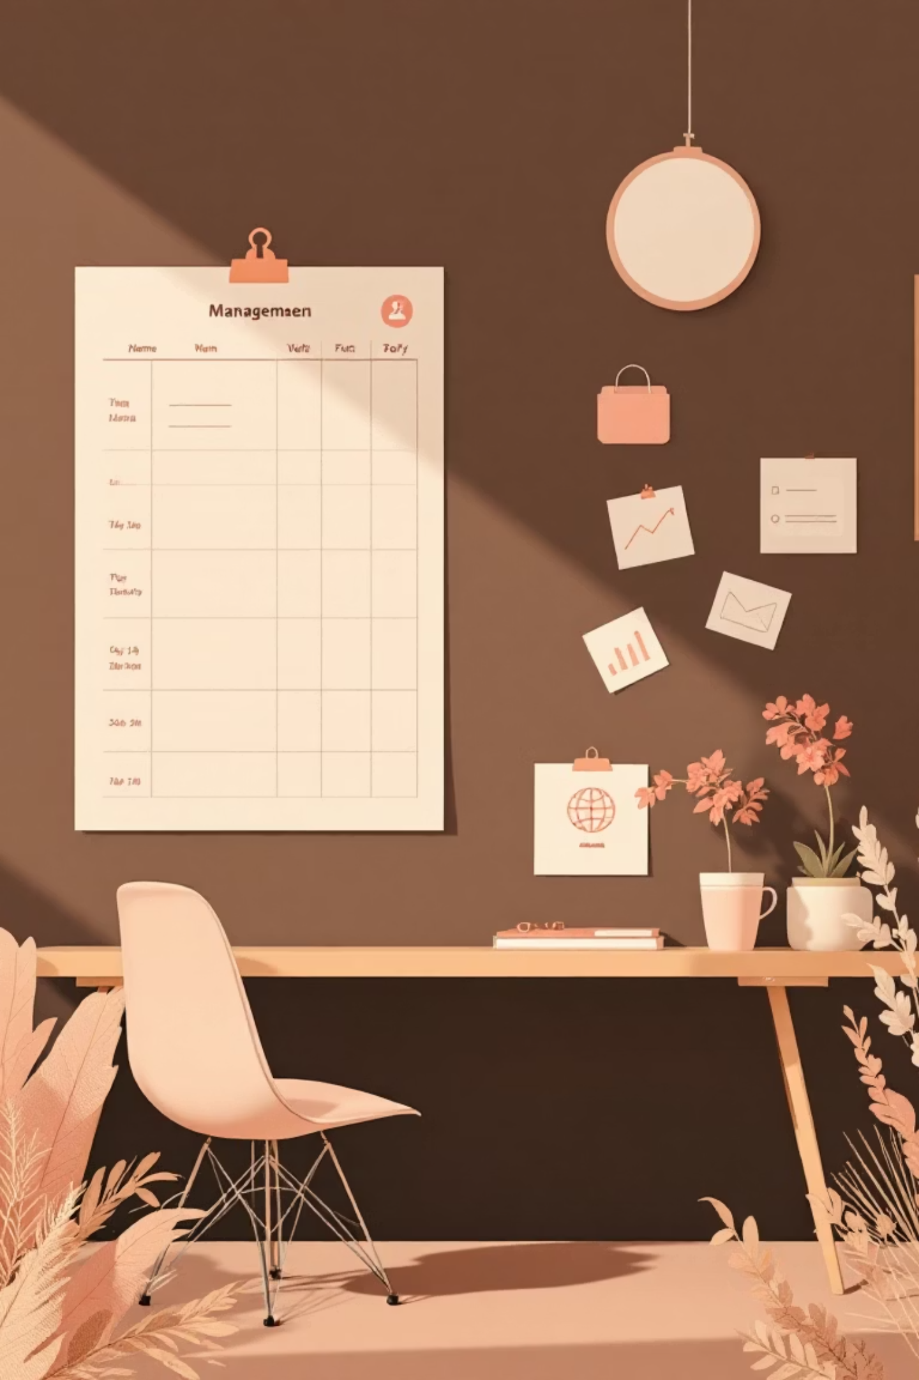




Calendar & Meeting Management
New Meeting vs Email
Schedule meetings directly from calendar view. Send meeting invites that automatically appear in attendees' schedules with all details included.
Scheduling Assistant
Check colleague availability before sending invites. View overlapping schedules to find the best meeting time for all participants instantly.
Adding Teams Links
One click adds Teams meeting links to any calendar invite. Enable virtual attendance and hybrid collaboration effortlessly.
Setting Reminders
Customize reminder alerts for meetings and deadlines. Receive notifications at intervals that work for your schedule and preparation needs.

Slide 7
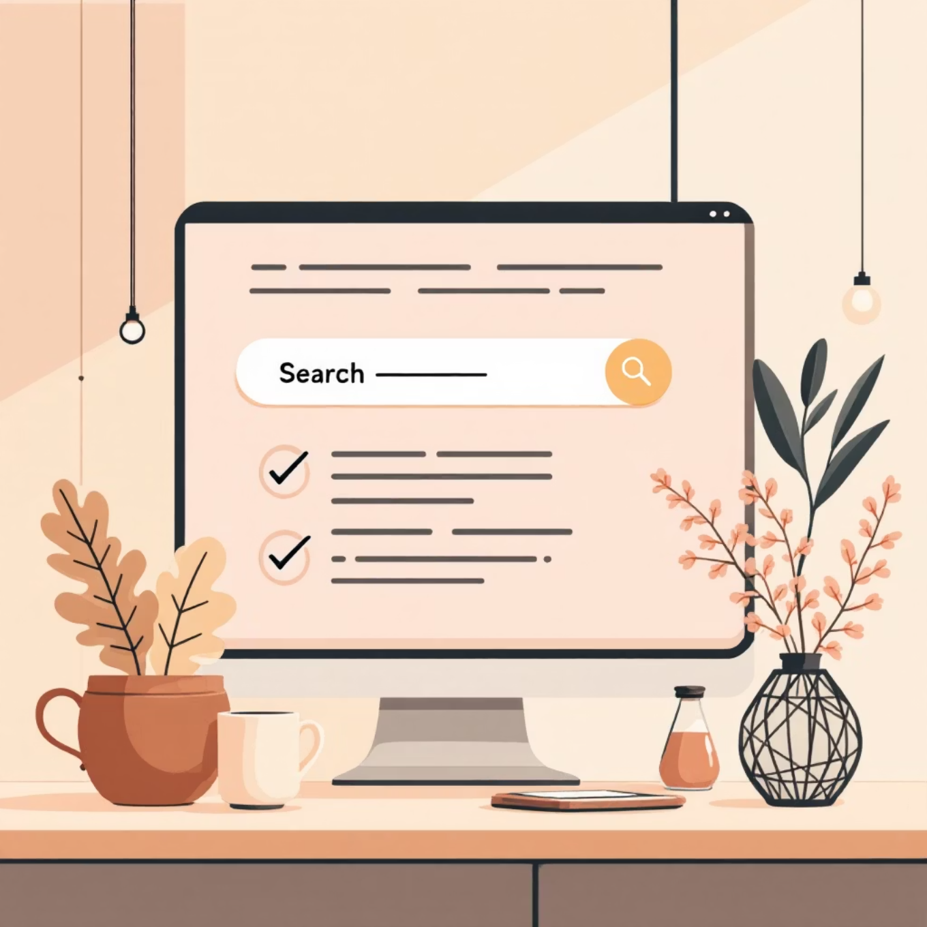
Search & Organization Strategies
Master the Search Bar
Search by Name or Keyword
Outlook's search functionality is your most powerful tool for finding information quickly in massive mailboxes with thousands of messages.
Type sender names, subject keywords, or message content to instantly retrieve relevant emails
Pro tip: Use advanced filters to narrow results and locate exactly what you need in seconds instead of minutes.
Apply Smart Filters
Refine searches by sender (From), date ranges, or attachments to pinpoint specific messages
Keep Folders Simple
Create 5-10 essential folders maximum. Over-organizing wastes time—search is faster than elaborate filing
Automate with Rules
Set up Rules to automatically sort incoming mail into folders based on sender, subject, or keywords

Slide 8
Five Quick Productivity Tips
Implement these game-changing strategies to reclaim hours every week and reduce email stress.
1. Use Rules
2. Delay Send
3. Manage Notifications
Automatically route newsletters, updates, and routine messages to designated folders. Your inbox stays focused on actionable items.
Schedule emails to send later during business hours. Write messages anytime while respecting colleagues' boundaries.
Turn off pop-ups and sounds for non-urgent mail. Check email intentionally instead of reacting to constant interruptions.
4. Leverage @Mentions
5. Time-Block Email
Direct attention to specific team members in group emails. Ensure accountability and faster responses on collaborative projects.
Process email during 2-3 dedicated blocks daily. Constant checking fragments focus and reduces overall productivity.

Slide 9
Real-Life Scenario: A Productive Day
See how Sarah, a college administrator, uses Outlook strategically to manage a busy workday efficiently.
8:00 AM - Multiple Emails Arrive
1
Sarah arrives to 47 new messages: urgent requests, routine updates, meeting invites, and departmental newsletters filling her inbox.
2
8:15 AM - Prioritize with Categories & Flags
She applies color categories (red for urgent, blue for projects, green for FYI) and flags three messages requiring responses by end of day.
9:00 AM - Schedule Meetings Using Calendar
3
Using Scheduling Assistant, Sarah finds a common time slot for four colleagues. She sends a Teams meeting invite with agenda attached.
4
4:30 PM - Search & Follow-Up Review
Before leaving, Sarah searches flagged items and uses Quick Steps to send status updates. She archives processed emails and reviews tomorrow's calendar.

Slide 10

Key Takeaways & Thank You
Outlook = Your Communication Hub
Centralize email, calendar, tasks, and contacts in one integrated platform for seamless workflow
Smarter Inbox Habits
Use categories, flags, rules, and search to transform email chaos into organized efficiency
Effective Scheduling
Master calendar tools, Scheduling Assistant, and Teams integration for better meeting management
Search + Rules = Efficiency
Leverage powerful search filters and automation to save hours weekly and never miss important messages
Thank you! I'm happy to answer questions.
Let's discuss how these strategies can work specifically for your role and workflow.

